Slide 1

WELCOME TO
LID POWER SOLUTIONS LIMITED
For better Solutions….

Slide 2
Company Overview
LID POWER SOLUTIONS LIMITED has been incorporated in November 2011. Backend in 2007.This Company concentrated mainly on Power Solutions ,Data Center Turnkey Solutions, building security like power protection, fire protection, precision air conditioning, and specialized itself with more investment, incorporation with new brands to fulfill it’s mission to be a leader in the country. As a result the Company now represents: All Power Products, Total Power and Industrial Solutions, UPS & Harmonic Equalizer, Stabilizer, Precision Air Condition , Mission Critical Monitoring & Management System, Water Detection &related Accessories, Interface, Monitoring& Management, ISEP Remote Alert System, Fire Extinguishing System etc. to provide our valued customer "One Stop Total Energy Solution" in Bangladesh.
LID POWER SOLUTIONS LIMITED

Slide 3
VISION
To be providing END to END solutions throw International & Local brand by in
house expert for cost effective ways.
MISSION
To assist valued clients with always latest technologies and experiences in power, DC
and ICT for improve productivity and achieving the business goals as well as society.
OUR POLICY
To providing defect free products & service to our customers and ensure required
delivery and post delivery services
LID POWER SOLUTIONS LIMITED

Slide 4
OFFICE LOCATION
Reg. Office : Setu Homes, Suite#5A-3, 55, Box Nagar, Zoo Road,Mirpur-01, Dhaka-1216
Space : 1250Sft
Phone : +88-01973480587
Email : russel@lidpowerbd.com
Corporate Office : House#1152, Road#9A,Avenue#11, DOHS, Mirpur, Dhaka.
Space : 2400Sft
Phone : +88-02-44801088
Email : mkt@lidpowerbd.com
Web : www.lidpowerbd.com
Warehouse & Service Center: House#13, Road#01, Block#B, Sector#06, Mirpur, Dhaka-1216
Space : (850+350)Sft.
Phone : +88-01711924647
Chittagong Office(01): 3,Khulshi Road, Chittagong. ; Mob: +88-01795094891
Chittagong Office(02): 56-57, Agrabad C/A, Chittagong. ; Mob: +88-01708515924
Singapore Liaison Office: 111 North Bridge Road,21-01, Peninusla Plaza, Singapore 179098
Email:sg@lidpowerbd.com
LID POWER SOLUTIONS LIMITED

Slide 5

LID POWER SOLUTIONS LIMITED
 | Service Point for All Over Bangladesh
01 | Service Center Dhaka Zone: House#13, Road#01, Block#B,Mirpur-02, Dhaka
02 | Service Center CTG Zone: MF Tower, 57/60, Badamtoli, Agrabad C/A, Chittagong.
03 | Service Center Rajshahi Zone: G-175 Sostitola, Rajshahi
04 | Service Center Sylhet Zone: 6-7 SairtiBhaban 1St Floor, Mirazajangal, Sylhet.
05 | Service Center Khulna Zone: House No 71 Road No 16 South Central Road, Khalispur Khulna
06 | Service Center Barisal Zone&Faridpur Zone: Vanga More Faridpur
07 | Service Center Bogura&Rangpur Zone: KornopurModdapara, Ward No-19 2nd Bypass, Bogura.

Slide 6

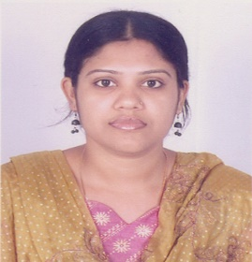
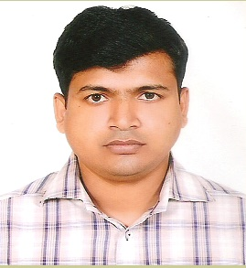
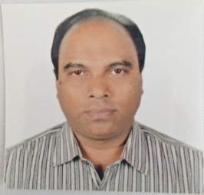
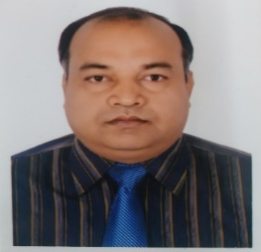
Management
The management is comprised of professionals, who are well-connected with local ICT and Power Industry and the local business world having wide experience in managing such business concern. Their relentless effort and endeavor has put LID POWER SOLUTIONS LTD. to a respectable stand from where it can take any future venture in this sector.
The Managing Director & all Directors are most experience more over 18 to 22 years in this field for service & marketing sector.
Name: Rokshima Rowshanara Mun Name: Md. Mahfuzul Hasan Russel
Designation: Chairman Designation: Mamaging Direct
E. Qualification: MA. E. Qualification: MBA(Marketing)
Experienced : 20 Years Experience in Marketing Experience: 10 Years Experience in Management or Power Products, Data Center, ICT etc.
and Operational activates.
Certification: Business English in British Council, Negotiation Skills in DCCI, Marketing is Everything in DCCI,
Professional Training: Socomec UPS Training in Singapore, Legrand UPS Training in India. E-Commerce Business in BCS.
Experience On: To promoted the Branding, provide the project forecast to the principal, pricing the products, yearly market planning, team lead, negotiation to the principal and the client, Fixing the target and achieving the Target,Take care the internal operations of the Company and develop the total group business by increase the market share via sales & marketing.
LID POWER SOLUTIONS LIMITED
Name:Md. Rezaul Karim Reza
Designation: Director
E. Qualification: M.Com(Management), MBA(Marketing)
Experienced : 21 Years Experience in Marketing for Power Products, Data Center, ICT etc.
Certification: Business English in British Council, Computer Course in BGS, Leadership in BRIDDHI, Supply Chain Management in BUET, Negotiation Skills in DCCI, Marketing is Everything in DCCI,
Professional Training: Socomec UPS Training in Singapore, Legrand UPS Training in India. E-Commerce Business in BCS, Project Management in BDJobs.
Experience On: To promoted the Branding, provide the project forecast to the principal, pricing the products, yearly market planning, team lead, negotiation to the principal and the client, Fixing the target and achieving the target, take care the internal operations of the company and to develop the total group business by increase the market share via sales & marketing.
Name:Md. Aktar Hossain
Designation: Director &Head of Tech
E. Qualification: BSC in EEE
Experienced : 22 Years Experience in Engineering for Power Products, Data Center.
Professional Training: Socomec UPS Training in Singapore, Legrand UPS Training in India.
Experience On: 17 Years for Service,Support, Installation of Socomec UPS, 05 Years Legrand & Vertiv UPS, Service Team Lead and Managerial activities.

Slide 7
Company Organogram
CHAIRMAN
MANAGING DIRECTOR
TECHNICAL DIRECTOR
MARKETING DIRECTOR
FINANCE DIRECTOR
GM,TECHNICAL
GM ,MARKETING
MANAGER,FINANCE
Manager, Pre-Sales
Manager, Sales & Marketing(1,2)
Manager, Accounts
Manager, Technical Support
Asst. Manager, Sales & Marketing(1,2)
Sr. Executive, Accounts
Asst. Manager, Support(1,2)
Sr. Executive, Sales & Marketing(1,2)
Manager, Admin.
Sr. Executive, Service & Support(1,2,3)
Executive, Sales(1,2,3)
Manager, Inventory & Logistic
Executive(Technician)
Service & Support(1-7)
Executive, Logistic(1,2)
LID POWER SOLUTIONS LIMITED

Slide 8
Our Strength
Work with World renowned Brand.
Engineers having more than 5 to 22 years of experience .
Certified Professional on Power & Data Center(18) etc.
Engineers have Good knowledge on products & Support.
We maintain full level spare parts in our stock.
We have wide space wire house for product availability.
Experienced & Knowledgeable Marketing Team.
We provide 24 X 7 support based on agreement
LID POWER SOLUTIONS LIMITED

Slide 9
Company Turn Over(BDT,Crore)
25.41
2014
LID POWER SOLUTIONS LIMITED
Notes:
3.95

Slide 10
Resources Persons
LID POWER SOLUTIONS LIMITED

Slide 11
Our Service Method
We have a long time experience a good numbers of Trained Engineers for ensuring after sales support.
We will provide round the clock service (7 X24x365 hours in a week). Response to a service Call will be within 02 hours in side Dhaka, Outside Dhaka within 02hours+ travel time except any natural disaster or unavoidable circumstances or it can be settled down by both the parties mutually. System up time will be 24 (Twenty-four) hours.
CLIENT
DIRECTOR
C TO
MD
SERVICE MANAGER
SUPPORT ENGINEERS
SERVICE ENGINEERS
AREA SERVICE CENTER
END USER
LID POWER SOLUTIONS LIMITED

Slide 12
OUR PRODUCT SOLUTIONS
» ON LINE UPS
»INVERTER & RECTIFIER
»SMF BATTERY
»AUTOMATIC VOLTAGE REGULATOR(AVR)
»PRECISION AIR CONDITION
»DATA CENTER INFRASTRUCTURE SOLUTIONS
»IPDU/VESDA
»AUTO FIRE SUPPRESION SYSTEM
»SECURITY SERVIELLIENCE SYSTEM
»VEDIO SERVEILLANCE SYSTEM(VEDIO WALL, VEDIO CONFERANCING)
»ICT SOLUTIONS
»TOTAL ELECTRICAL SOLUTIONS
LID POWER SOLUTIONS LIMITED

Slide 13







OUR SOLUTIONS PARTNER
LID POWER SOLUTIONS LIMITED

Slide 14
TARGET MARKET
Manufacturing & RMG (M & RMG, Knitwear) ***
Financial Services Industry (FSI)
Ceramic and food Industries
Health Care & Pharmaceutical (H & P)
Public Sector & Education (PS & E)
Multinational & UN Org (MNC)
Communications, Media & Entertainment (CME)
Others (NGO & Selected Local Group)
LID POWER SOLUTIONS LIMITED

Slide 15


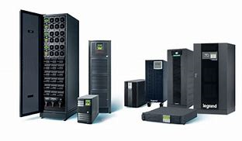
LEGRAND UPS Range
LID POWER SOLUTIONS LIMITED

Slide 16

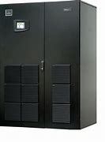
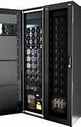
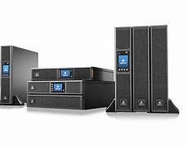
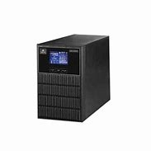
VERTIV UPS Range
LID POWER SOLUTIONS LIMITED

Slide 17

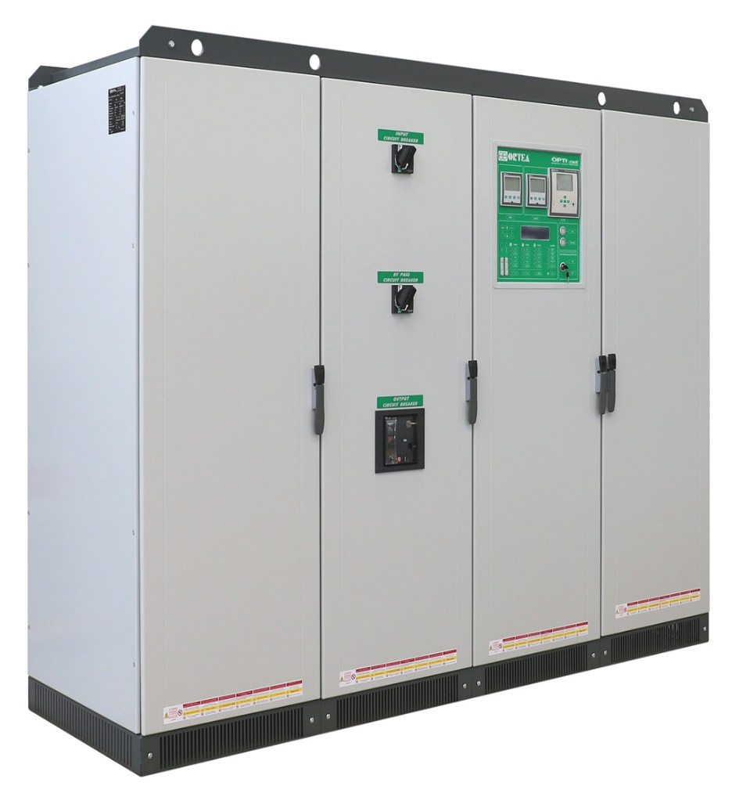
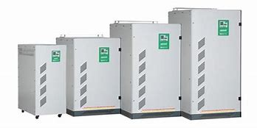

ORTEA AVR Range

Slide 18

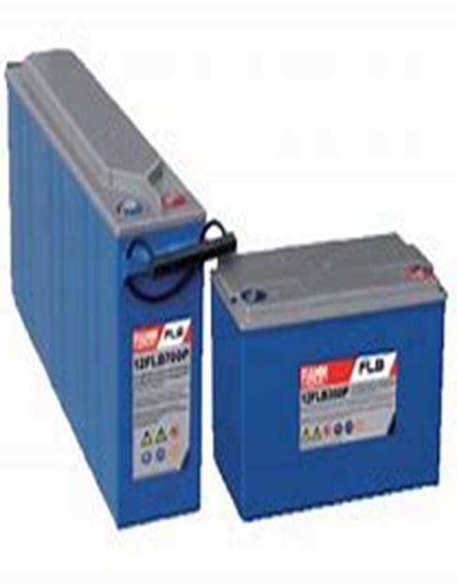
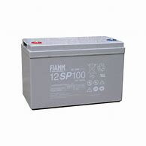
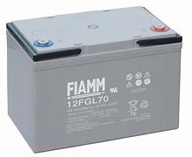
FIAMM Battery Range

Slide 19
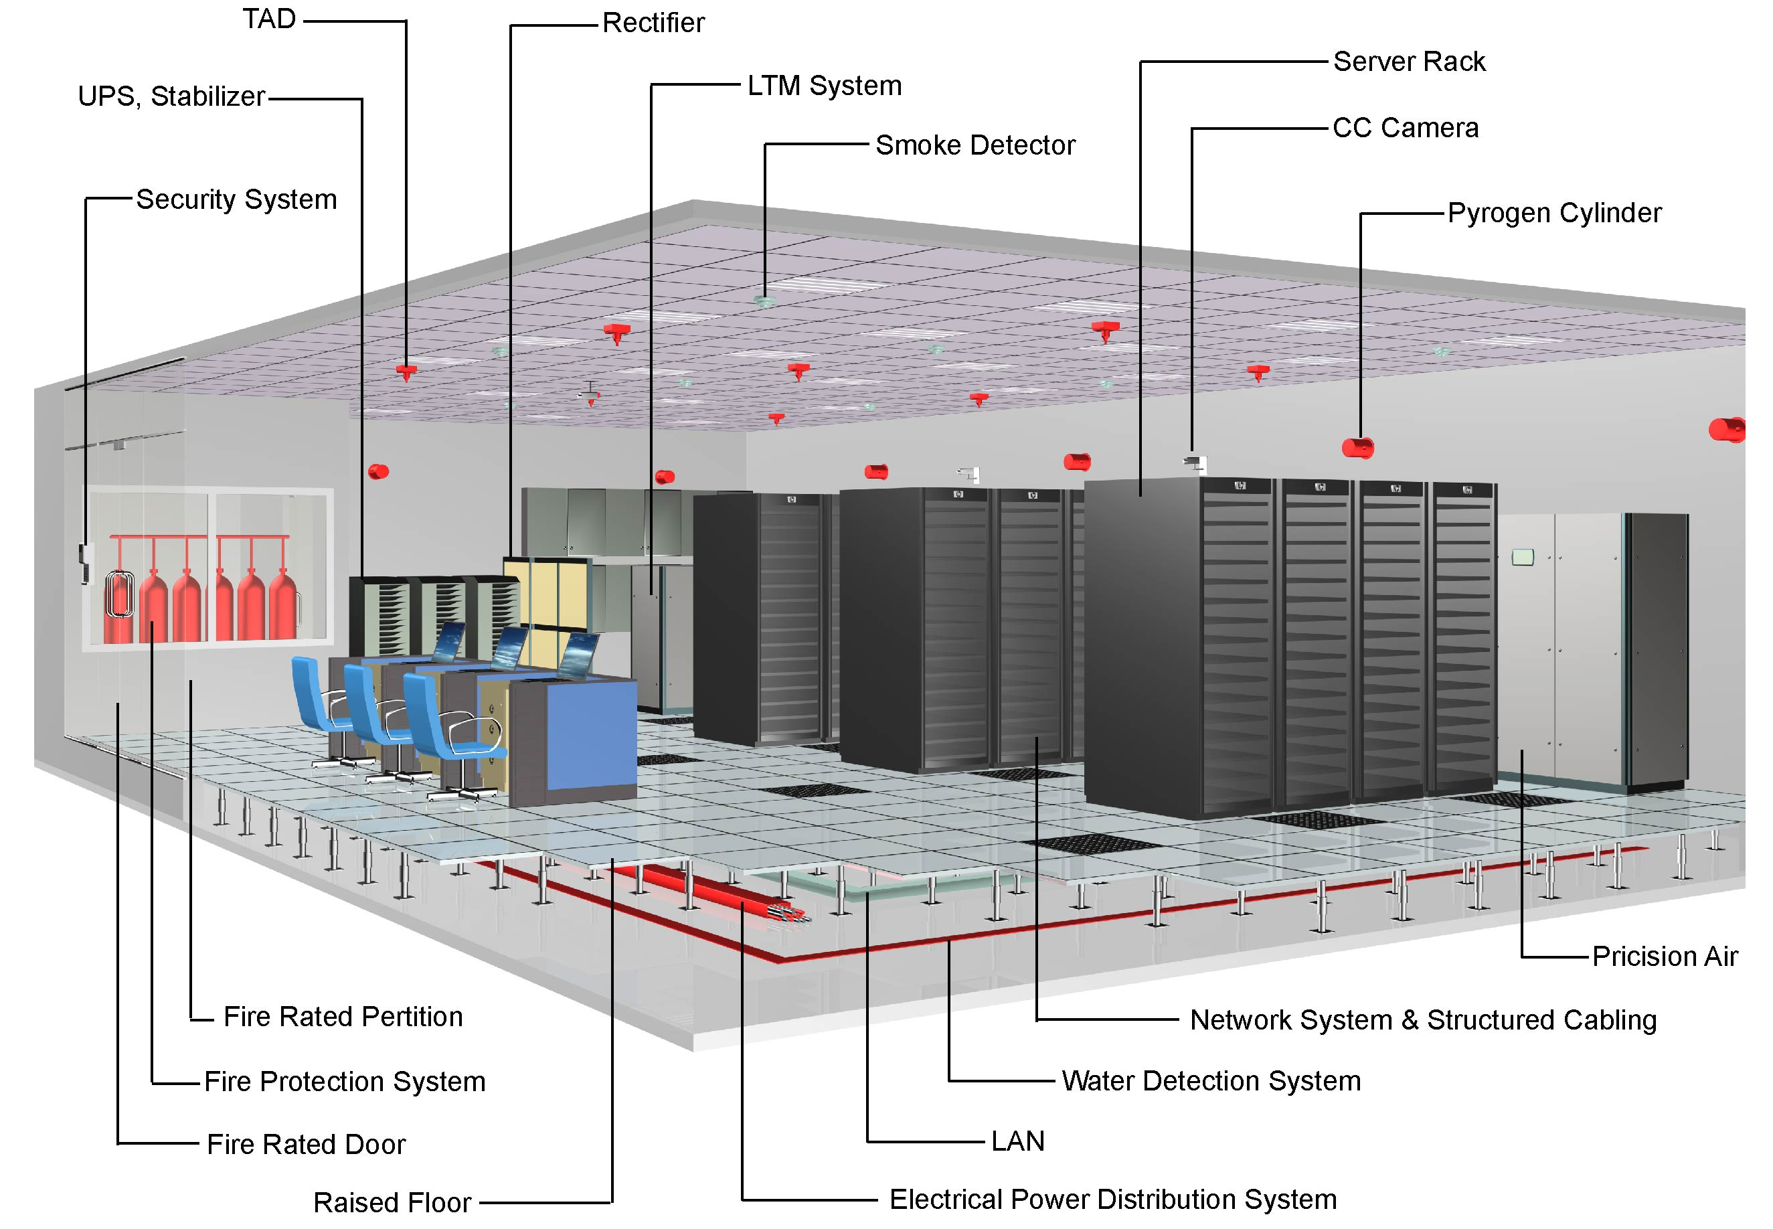
DATA CENTER SOLUTIONS
LID POWER SOLUTIONS LIMITED

Slide 20





















SOME OF OUR MAJOR CLIENT
Soorty Textiles (Bd) Ltd.
LID POWER SOLUTIONS LIMITED

Slide 21
List of Engineer’s Bio Data for Service & Support Team:
Sl# | Name of Employees | Working Experience
01 | Md. Aktar Hossain B.Sc Engineer in Electrical & Electronics. Director & Head of Technical. Mob: 01730717345 | Working experience in 25 years in the field of digital electronics products like On-Line UPS, Off-Line UPS, Inverter, Voltage Stabilizer, Industrial Voltage Stabilizer(IVS), Sub-Station Equipment in design, production, installation, service and customer communication. Certified Engineer of various On Line UPS Like Socomec, Legrand, Emerson, Delta, Elen, G-tec and others)
02 | Mr. Pankaj Kumar Paul M.Sc. Engineer in Electrical & Mechanical , Technical Advisor. Mob: 01780005511 | Working experience in 40 years in the Technical field especially Electronic products & Medical sector. Electrical products like On Line UPS, Voltage Stabilizer, Inverter etc installation, Trouble shooting, Service and others. Certified Engineer of SIEL, Socomec & Emerson UPS.
03 | Md. Mohsin Muktadir B.Sc. Engr. In EEE Senior Manager (Service & Support) Mob: 01911734009 | Working experience in 15 years in the field of digital electronics products like On-Line UPS, Off-Line UPS, Inverter, Voltage Stabilizer, Industrial Voltage Stabilizer(IVS), maintenance free battery, Electrical Sub-station Equipment in design, production, installation, service and customer communication. Certified Engineer of Socomec, Emerson, Riello UPS.
04 | Mezbaul Hasan Sowrob B.Sc. Engr. in EEE Manager(Service & Support) Mob:01714066375 | Working experience in 12 years in the field of digital electronics products like On-Line UPS, Off-Line UPS, Inverter, Voltage Stabilizer, Industrial Voltage Stabilizer(IVS), maintenance free battery, Electrical Sub-station Equipment in design, production, installation, service and customer communication. He is well known of Socomec, Emerson, Delta, Legrand UPS.
05 | Md. Gulam Mostafa B.Sc. Engineer in Electrical & Electronics Manager(Service & Support) Mob:01769914462 | Working experience in 10 years in the field of digital electronics products like On-Line UPS, Off-Line UPS, Inverter, Voltage Stabilizer, Industrial Voltage Stabilizer(IVS), maintenance free battery, Electrical Sub-station Equipment in design, production, installation, service and customer communication. He is well known of Socomec, Emerson, Delta, Legrand UPS
06 | Md. Mahbubur Rahman Diploma Engineer In Electronics Executive(Service & Support) Mob: 01714066379 | Working experience in 10 years in the field of digital electronics products like On-Line UPS, Off-Line UPS, Inverter, Voltage Stabilizer, Industrial Voltage Stabilizer(IVS), maintenance free battery, Electrical Sub-station Equipment in design, production, installation, service and customer communication.
07 | Md. Masum Parvez B.Sc. Engineer in EEE Asst. manager(Support) Mob:01714066374 | Working experience in 7 years in the field of digital electronics products like On-Line UPS, Off-Line UPS, Inverter, Voltage Stabilizer, Industrial Voltage Stabilizer(IVS), maintenance free battery, Electrical Sub-station Equipment in Design, production, installation, service and customer communication.
08 | Md.Monir Hossain Diploma Engineer In Electronics Executive(Service & Support) Mob:01714066376 | Working experience in 08 years in the field of digital electronics products like On-Line UPS, Off-Line UPS, Inverter, Voltage Stabilizer, Industrial Voltage Stabilizer(IVS), maintenance free battery, Electrical Sub-station Equipment in Design, production, installation, service and customer communication.
09 | Md. Maznur Rahman B.Sc. in Electrical Asst. Manager(Service & Support) Mob:01741930101 | Working experience in 12 years in the field of digital electronics products like On-Line UPS, Off-Line UPS, Inverter, Voltage Stabilizer, Industrial Voltage Stabilizer(IVS), maintenance free battery, Electrical Sub-station Equipment in design, production, installation, service and customer communication. He is well known of Socomec, Emerson, Delta, Legrand UPS.
10 | Md. Alamgir Hossain Diploma Engineer Executive(Service & Support) Mob:01714066378 | Working experience in 08 years in the official experience in Power Station Equipment & large Industrial sector as the operation of project. Now directly involved in consulting work in the power sector and private industries as an installer, operation and commissioning with training to the employees or industrial training of respected persons.
11. | Md. Mohidul Hossain Diploma in Electrical Senior Executive (Service & Support) Mob:01764203314 | Working experience in 15 years in the official experience in Power Station Equipment & large Industrial sector as the operation of project. Now directly involved in consulting work in the power sector and private industries as an installer, operation and commissioning with training to the employees or industrial training of respected persons.
12. | Md. Shahadat Hossain Diploma in Electrical Senior Support Engineer Mob:01740581207 | Working experience in 15 years in the industrial & machineries experience with sub-station & Power Station Equipment like the operation of project. He is capable of the industrial sector as an installer, operation and commissioning of any types of machineries and micro-processor based electronics equipment
13. | Md. Ruhul Amin. Diploma in Electronics . Executive(Service & Support) Mob:013 17202123 | Working experience in 4 years in the field of production and service of electronics products like On-Line UPS, Off-Line UPS, Inverter, Voltage Stabilizer, Industrial Voltage Stabilizer(IVS) etc. and Electrical Sub-station Equipment.
14. | Md. Tushar Ali Diploma in Electrical Service Engineer Mob:01712215103 | Working experience in 5 years in the field of service of electronics products like On-Line UPS, Off-Line UPS, Inverter, Voltage Stabilizer, Industrial Voltage Stabilizer(IVS) etc. as He supervised a small team of service department for home service, office service, industries as per customer’s call and as per annual agreement contact with the clients.
15. | Md.Shaidul Islam Diploma Engineer Executive(Service & Support) | Working experience in 5 years in the field of Technical Service of electronics products like On-Line UPS, Off-Line UPS, Inverter, Voltage Stabilizer, Industrial Voltage Stabilizer(IVS) etc. as a Jr. Executive Service. Completed the Vocational Trade Course, 3-yaers.
16. | Md. Taimur Hassan Diploma Engineer In Electronics Senior Executive(Service & Support) | Working experience in 14 years in the electronics & electrical sub-station Equipment like the operation of project. Now directly involved as a consultant with LID POWER SOLUTIONS Ltd. He is capable of service micro-processor based electronics equipment with soft wear and train-up the employees as per agreement & condition of industries.
17. | Md. Masum Hossain Diploma Engineer In Electronics Technician | Working experience in 02 years in the electronics & electrical sub-station Equipment like the operation of project. Now directly involved as a consultant with LID POWER SOLUTIONS Ltd. He is the service micro-processor based electronics equipment with soft wear and train-up the employees as per agreement & condition of industries.
18. | Md.Rakibul Hassan Diploma Engineer In Electronics Technician | Working experience in 02 years in the electronics & electrical sub-station Equipment like the operation of project. Now directly involved as a consultant with LID POWER SOLUTIONS Ltd.
19. | Md Masum Billah Diploma Engineer In Electronics Technician | Working experience in 01 years in the electronics & electrical sub-station Equipment like the operation of project. Now directly involved as a consultant with LID POWER SOLUTIONS Ltd.
20. | Md Zahidul Islam Vocational In Electronics Executive(Service & Support) | Working experience in 6 years in the field of customer service of electronics products like On-Line UPS, Off-Line UPS, Inverter, Voltage Stabilizer, Industrial Voltage Stabilizer(IVS) etc. Completed the Vocational Trade Course, 3-yaers.
LID POWER SOLUTIONS LIMITED

Slide 22
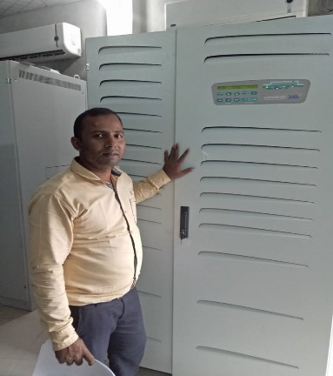
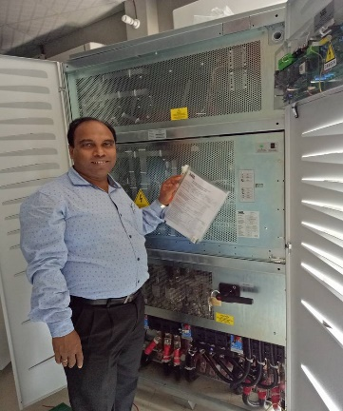
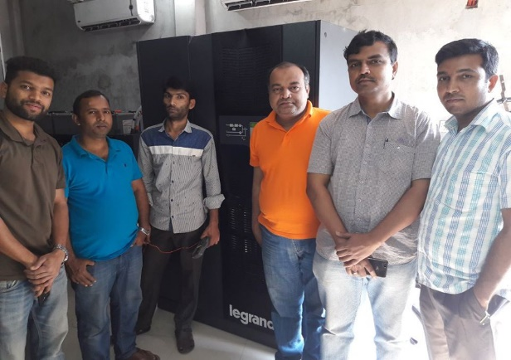
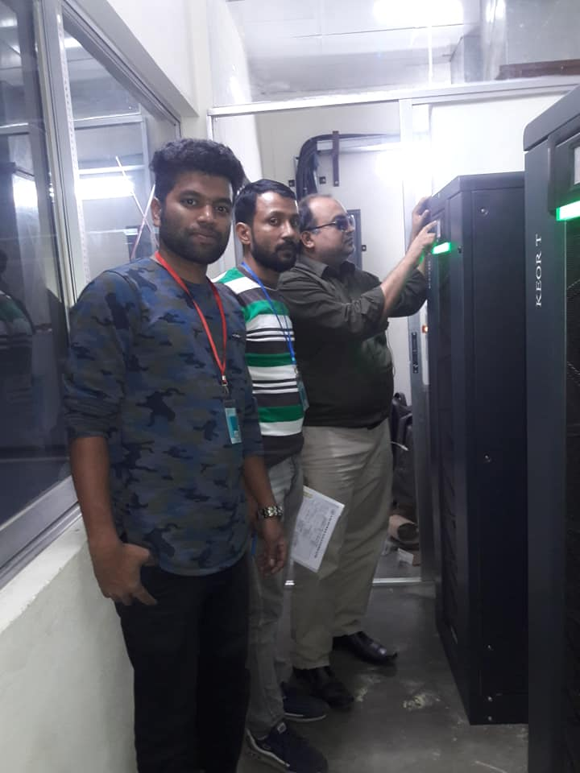
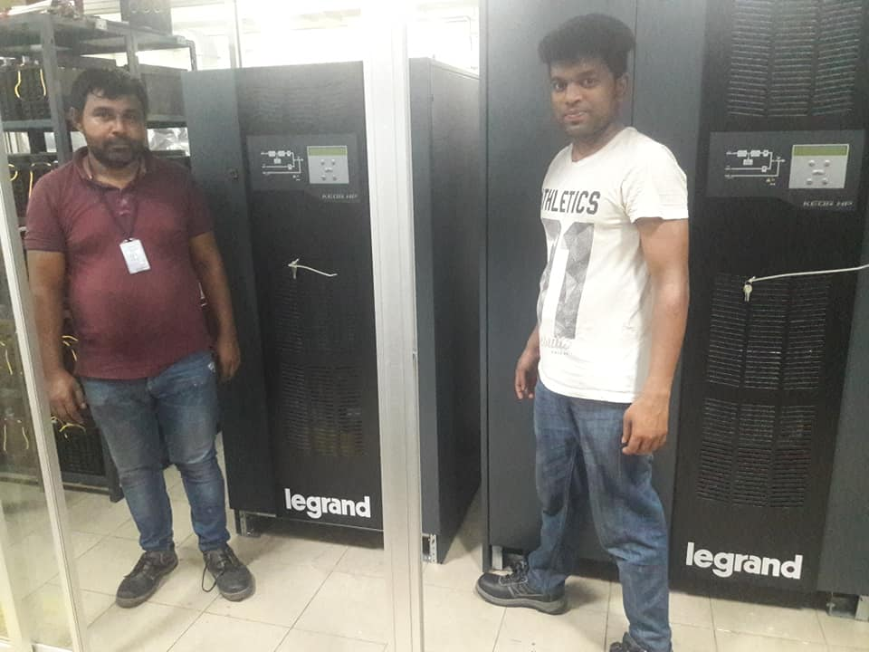
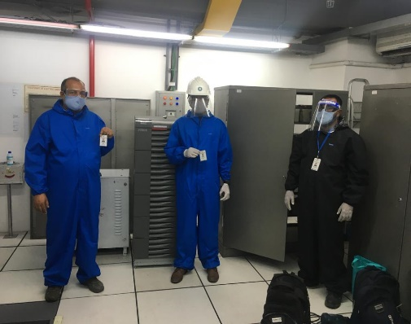
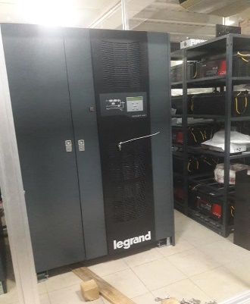
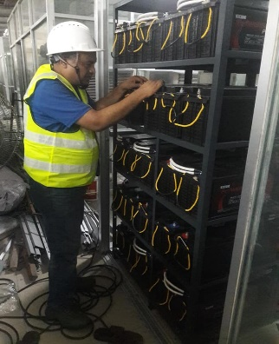
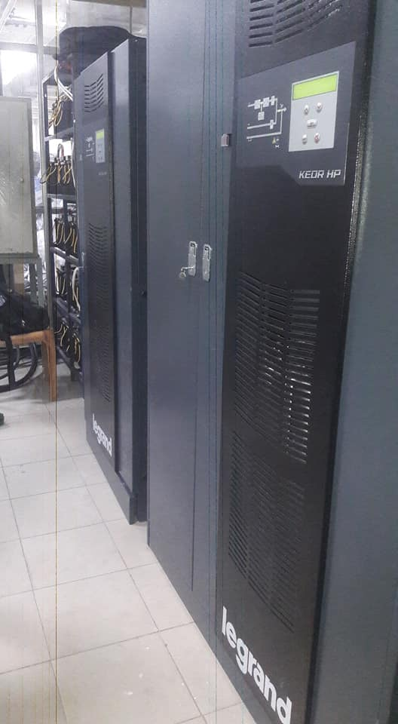
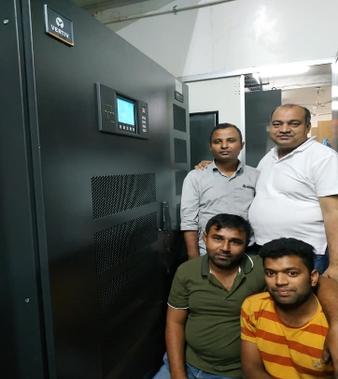

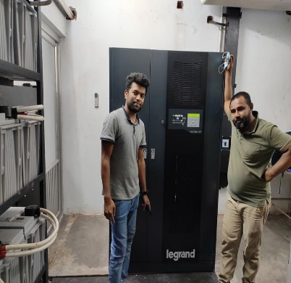
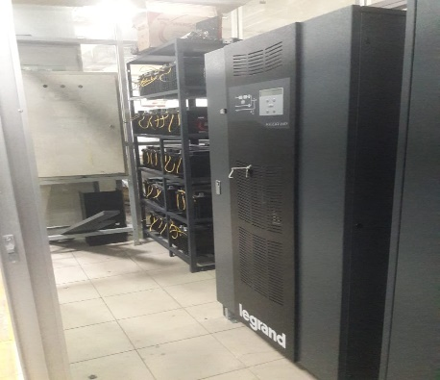
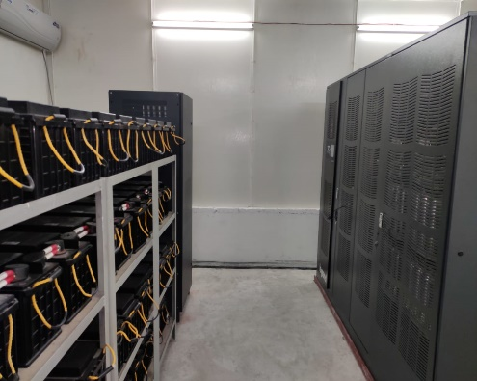
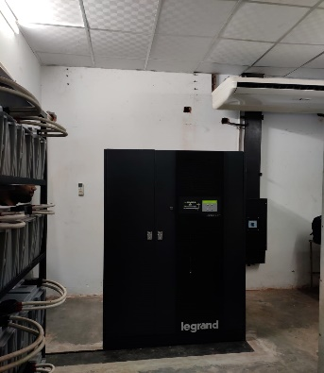
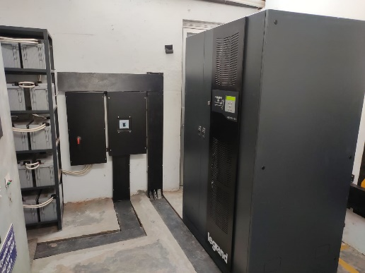
Some successful Projects
Color Oven Bag-250KVA Meghna Febrics-200KVA Bags & Packs Ind.-250KVA Shasha Denims-160KVA Perfetti Ven-250KVA
Citi Bank N.A-80KVA
SQ knitting & Dying 200KVA
SQ Huges Industries-250KVA
Young Optics-160KVA
Asiya Poly Bag-200KVA
Badsha FishNet-200KVA
Jalal Accessories-500KVA
Baraka Potenga Ltd.-800KVA
Salma Filament-200KVA
Fine Sweaters-300KVA
LID POWER SOLUTIONS LIMITED

Slide 23

LID POWER SOLUTIONS LIMITED

